Slide 1

ALTERNATING DIRECTION METHOD OF MULTIPLIERS
DEEPTHI SUDHARSAN
(CB.EN.U4AIE19022)

Slide 2
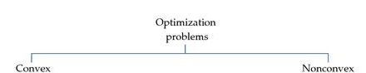
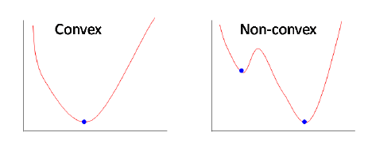
OPTIMIZATION
Optimization is finding the best/optimum output by maximizing or minimizing a given function such that it also satisfies certain constraints.
The optimization is convex or non convex based on whether or not its objective function or any of its constraints are convex or non-convex.
Convex optimization is regarded to have a smooth output and whereas the non-convex optimization is a non-smooth output.

Slide 3
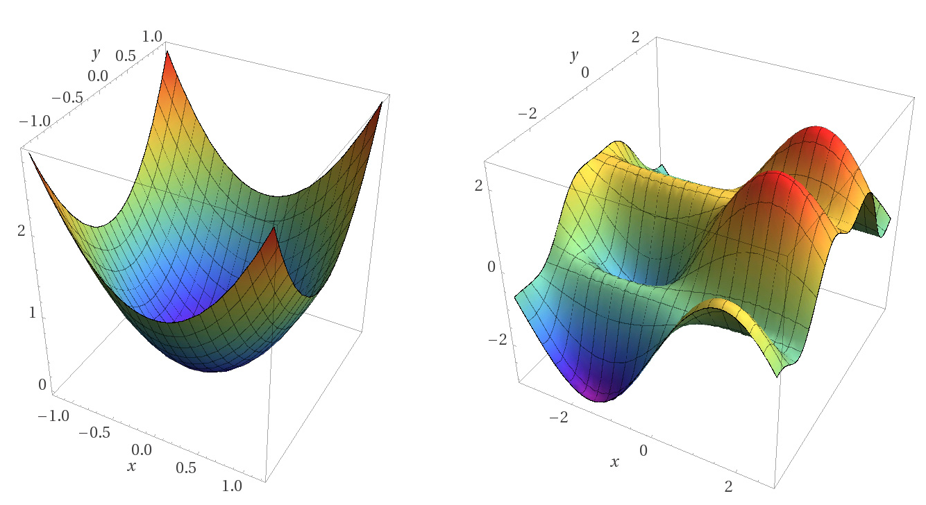
ADMM
ADMM is a powerful iterative algorithm that solves convex optimization problems by breaking them into smaller pieces. It is a modification of the augmented Lagrangian that partially updates the dual variables over iterations.
NOTE: ADMM on nonlinear equality problems are difficult to solve as the nonlinear equality constraint makes subproblems nonconvex. When it comes to ADMM on non-convex optimization problems, we can find only local minimum but we cannot guarantee that our method will reach our desired solution.

Slide 4
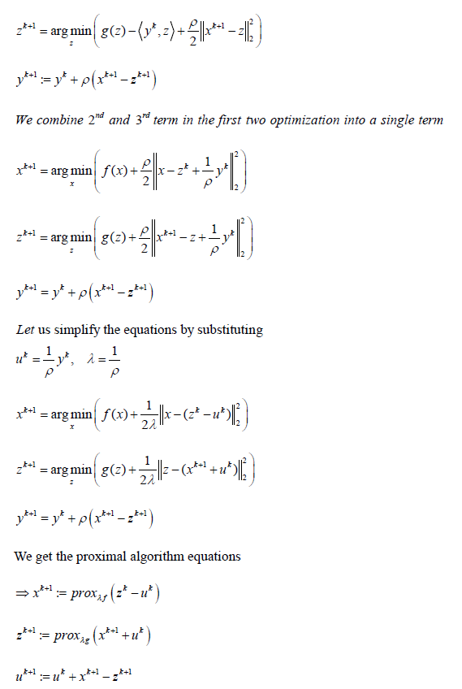
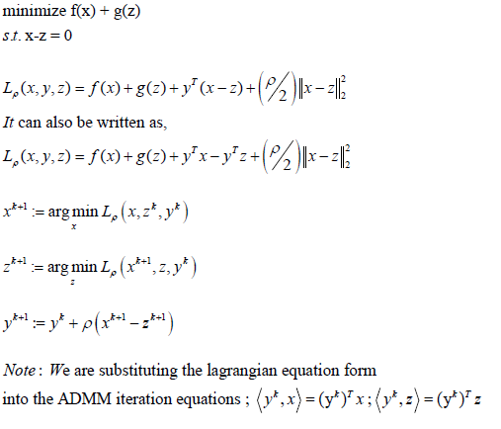

How to approach [convex] ADMM Problems? (2 Methods)
1

Slide 5
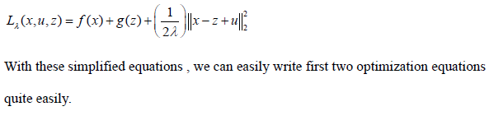
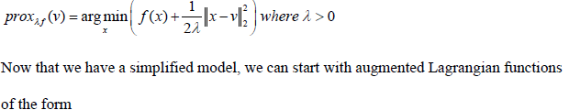
How to approach [convex] ADMM Problems? (2 Methods)
2
Another form of ADMM is where the equality constraints actually lie over a region.
We convert it into
Where,g(z) is the indicator function and
Augmented Lagrangian function can be written as

Slide 6
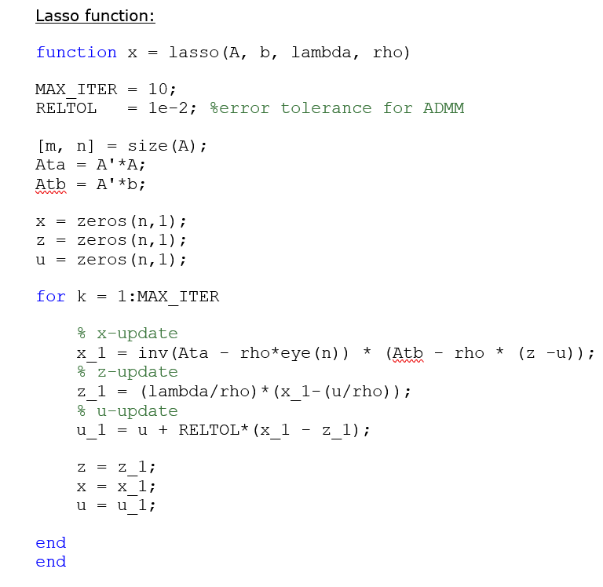
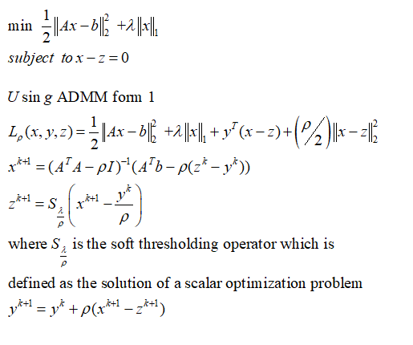
EXAMPLES OF ADMM AND CODE
1
LASSO
NOTE: For large value of ‘n’, relaxation and shrinkage method of solving converges faster. Shrinkage will come if l1 norm there in the formulation. Relaxation is
for faster convergence.

Slide 7
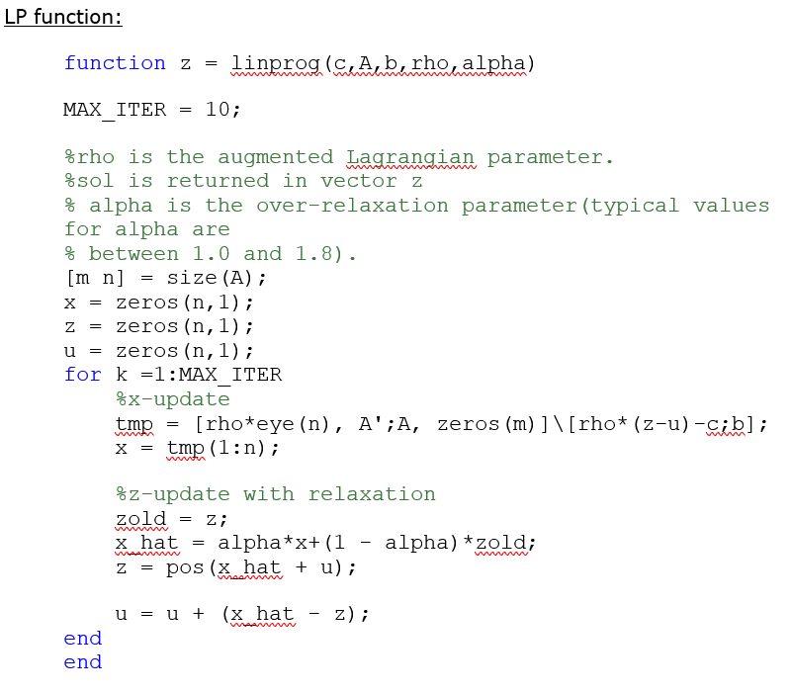
EXAMPLES OF ADMM AND CODE
2
LINEAR PROGRAMMING

Slide 8
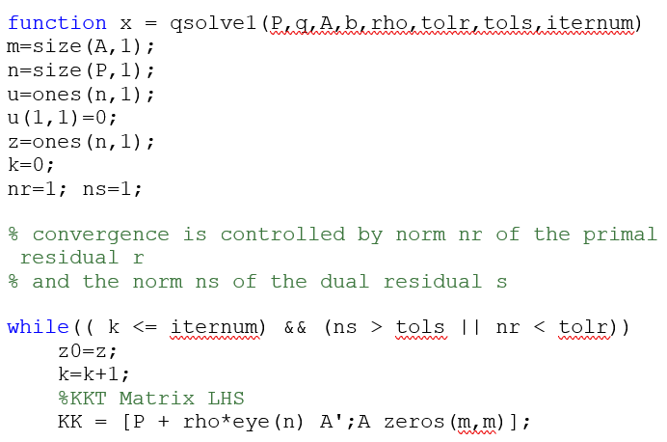

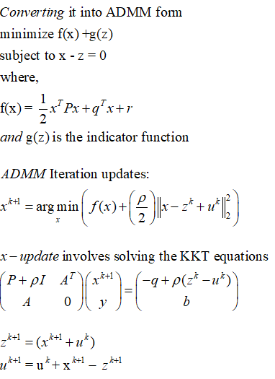
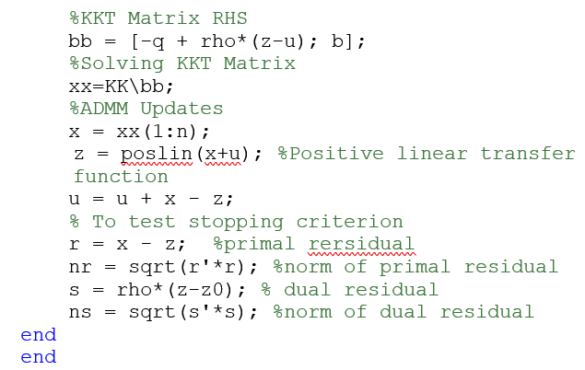
EXAMPLES OF ADMM AND CODE
3
QUADRATIC PROGRAMMING

Slide 9
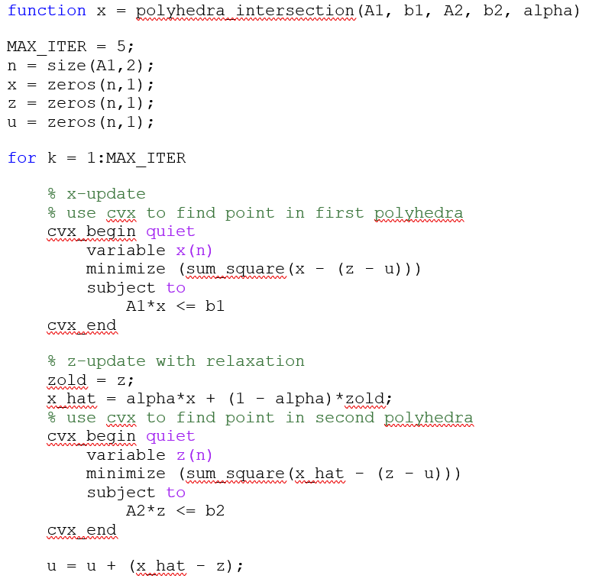
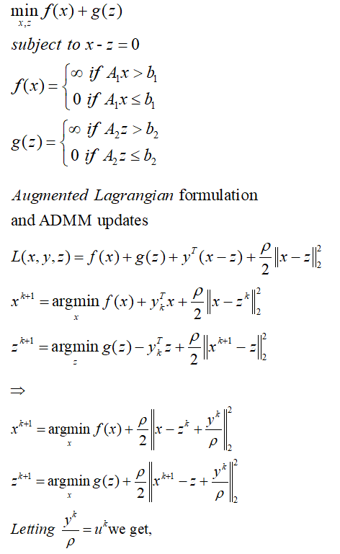

EXAMPLES OF ADMM AND CODE
INTERSECTION OF POLYHEDRAL
4
end
end

Slide 10
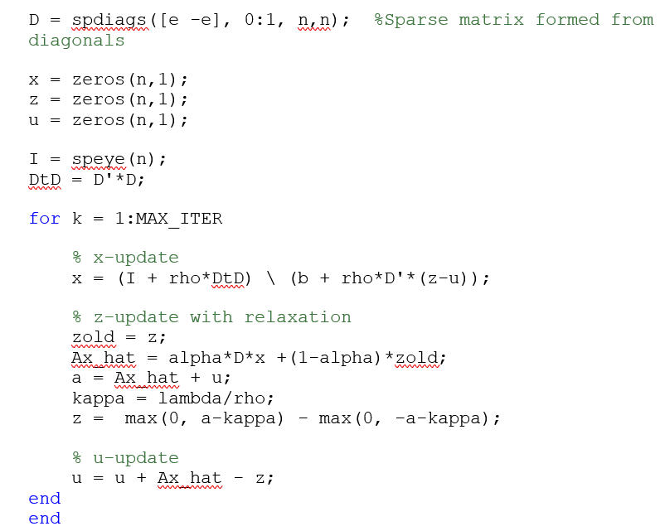
EXAMPLES OF ADMM AND CODE
TOTAL VARIATION MINIMIZATION
function x = total_variation(b, lambda, rho,alpha)
MAX_ITER = 1000;
n = length(b);
e = ones(n,1);
5

Slide 11
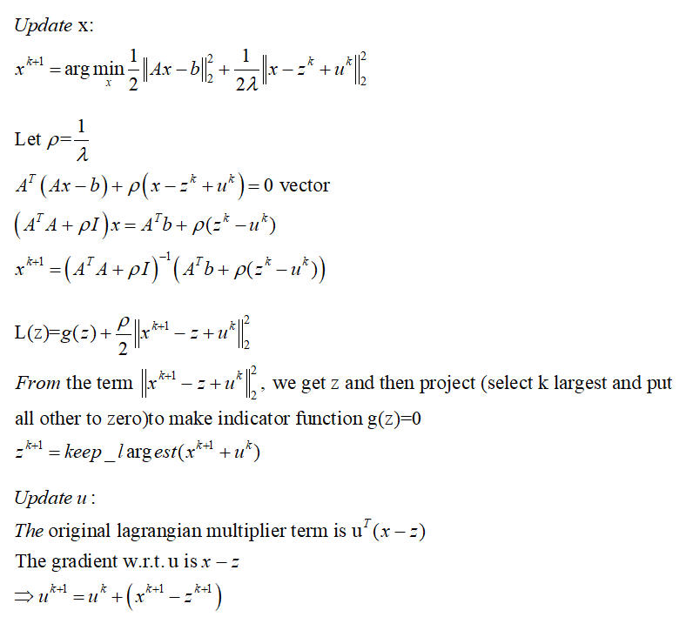
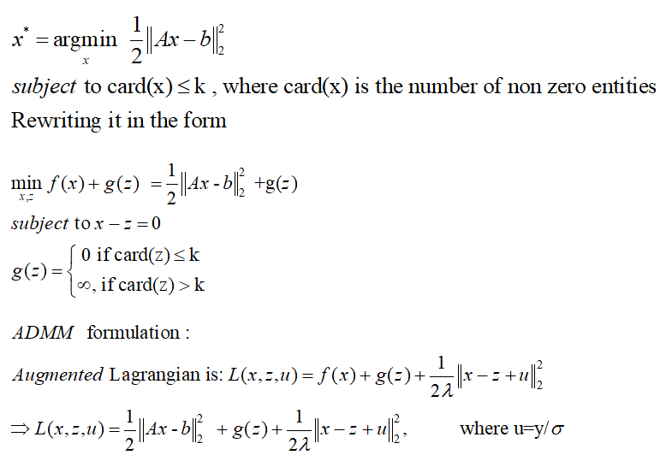
EXAMPLES OF ADMM AND CODE
REGRESSOR SELECTION (NON CONVEX)
6

Slide 12
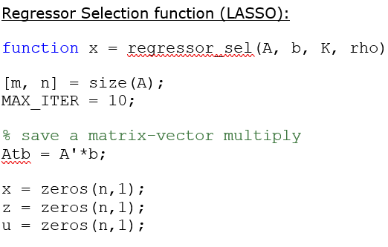
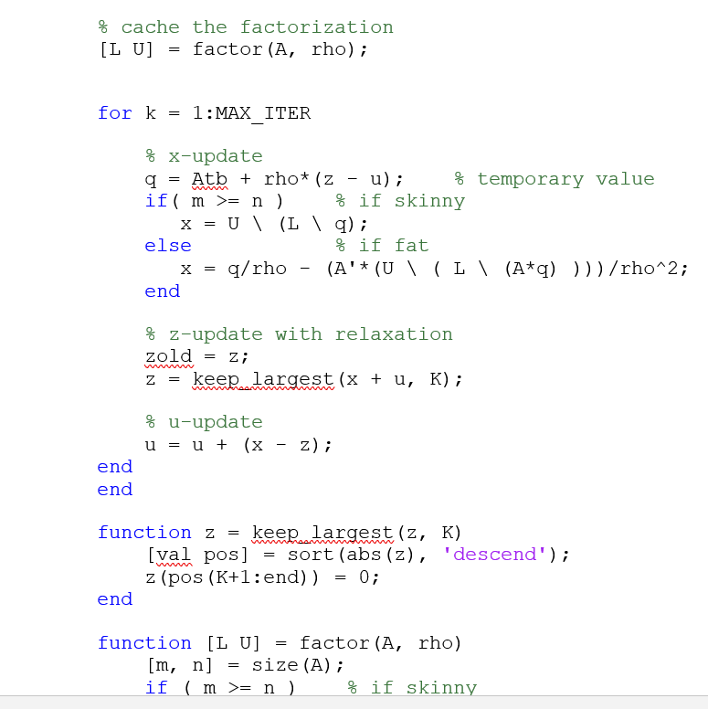
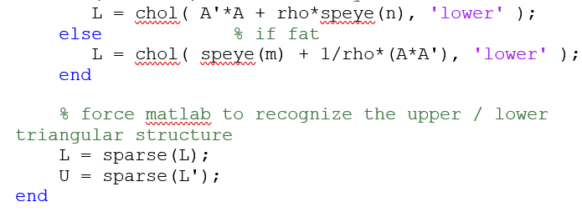
EXAMPLES OF ADMM AND CODE
6

Slide 13
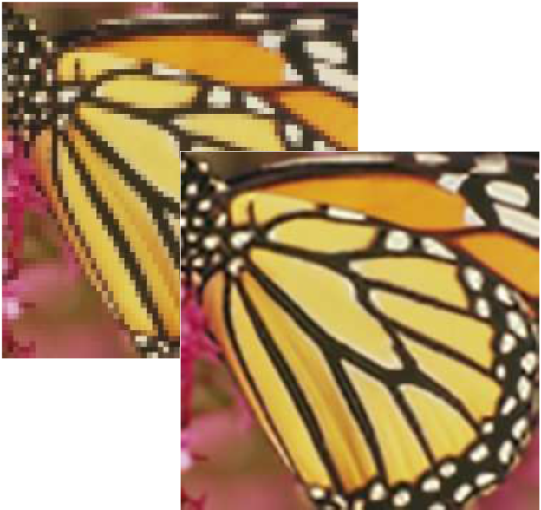
APPLICATIONS
Some applications of Distributed Reinforcement Learning
Filter Denoising
Image Restoration
Decentralized demand response method in electric vehicle virtual power plant.
Used for maximizing Weight Pruning
Energy Management of ancillary systems
ADMM based privacy-preserving decentralized optimization
Approach to informative trajectory planning for multi target tracking

